Slide 1
DEVELOP AN OUTCOME L2
Evidence of Learning Template
YOUR NSN NUMBER HERE
Connect 4
Ethan Chester

Slide 2
Github /Drive link
https://drive.google.com/drive/folders/1psKbPVENKz_XtAOOOsbfxUEA2zdTXw1e?usp=sharing (v6 is the final version)
Trello board or PM link
https://trello.com/b/84MqOiBQ/connect-4
You MUST provide evidence showing how the problem has been decomposed, how the components have been developed and trialled, and of how they have been assembled and tested to create a final, working outcome.

Slide 3
Planning
My aim is to create a connect 4 game. This game will function by drawing up a 7 x 6 square board in which two players will take turn placing one of their counters in a column to try to be the first player to have four of their counters in a row, vertically, horizontally or diagonally. I will create this game in python in visual studios code and I aim to finish it in four weeks using the knowledge of python I have learnt in class.

Slide 4
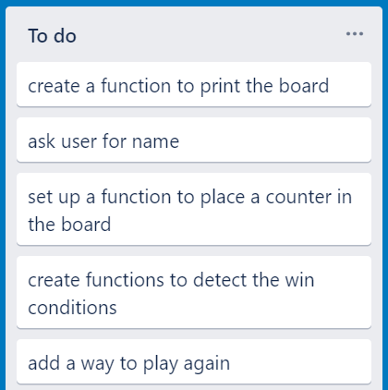
Project management
I chose to use trello to manage my project because I find it very easy to use and it allows me to break my project into sections that I can easily deal with individually and I can have a clean visual reference of what I have done and what I have yet to do. I thought about using the windows calendar app but I decided to use trello instead because I really like being able to move tasks to a different column when I have finished them to clearly see what I have done and what is left to do and the windows calendar doesn’t have this feature. I used the agile method to manage my project. This means that I did my work in cycles of planning, developing and evaluating for each component so that I could be certain that when I finished a component it would work as I needed it to. I chose to do this instead of using waterfall technique because I wanted to plan and evaluate each section before and after implementing it to avoid ending up with a lot of errors throughout my code.

Slide 5
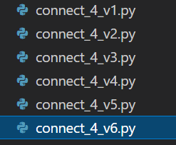
Version control
I decided to implement version control by cloning my project whenever I am about to make a major change. This allows me to compare my current code with my previous code to check why certain changes work or not. I created a new file every time a milestone was reached in my code. I chose to use this method instead of github because I do not have github setup and I find this method relatively easy to do especially since it doesn’t require any program other than visual studio code.

Slide 6
Decomposing outcome
Record evidence that you have broken the outcome into smaller components.
I have decomposed my project into its smaller components. I first broke it down into the larger tasks - board creation, counter movement and detection and the game initiation and ending all of which I have broken down into smaller tasks. I did this so that I can easily work on each component individually and clearly see where it fits into the whole connect 4 program.
Large Tasks
Board creation
Counter movement and detection
Game start and end
Task | Size
Create Board List | S
Create Board | S
Place Counter | M
Detect Win | L
Get Name | M
Play Again | M

Slide 7
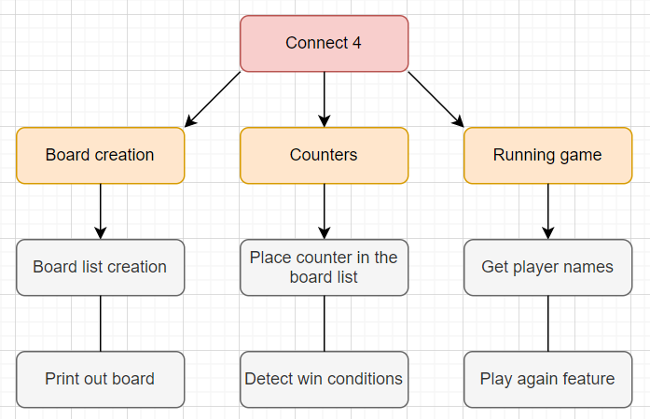
Decomposing outcome - Intro
My program is a version of connect 4, designed for anyone to be able to sit down with a friend and play without any unnecessary complications. Connect 4 is a game where 2 players take turns placing a counter in a column of a board to try to be the first player with 4 of their counter in a row. I have used colours to make it as easy as possible for the users to clearly see which counters are each player’s. I also added a component to detect when a player has won. This is so that players will never miss a win condition and also so the game will end when a winner is declared. I created a play again function so there is an easy way for the users to start again if they want to. This component always has the loser of the last game go first in the next.

Slide 8
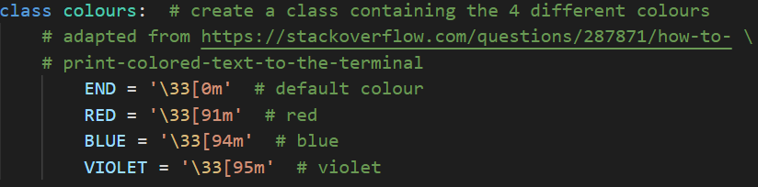
Decomposing outcome - Colours
I used a class to set up colours for my program. This is because it was easy to set up and works very effectively for all sections I need colour for. I adapted the code from https://stackoverflow.com/questions/287871/how-to-print-colored-text-to-the-terminal. This method was very easy to implement wherever I needed it. I added colours to make the counters very clear for the users to be able to differentiate between.

Slide 9
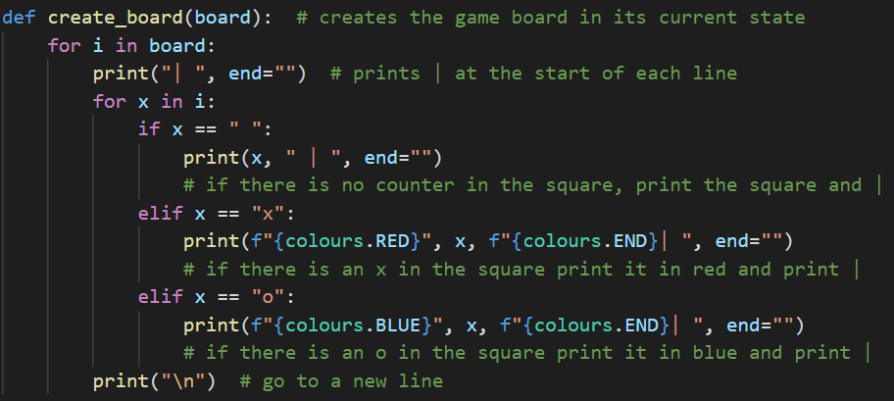
Decomposing outcome - Create Board
I made a function that I can call each time I want to draw the board. I used nested loops to make it as efficient as possible. This section implements the colours for the counters.

Slide 10
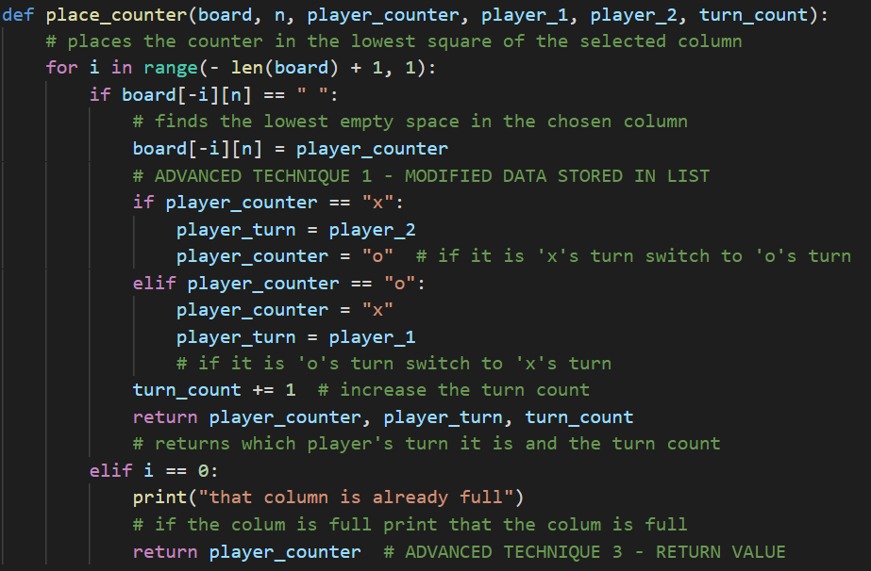
Decomposing outcome - Place Counter
I used a function with nested loops to place the player’s counter in the desired column at the lowest possible empty position. If the selected column is already full, the program will not attempt to place a counter.

Slide 11
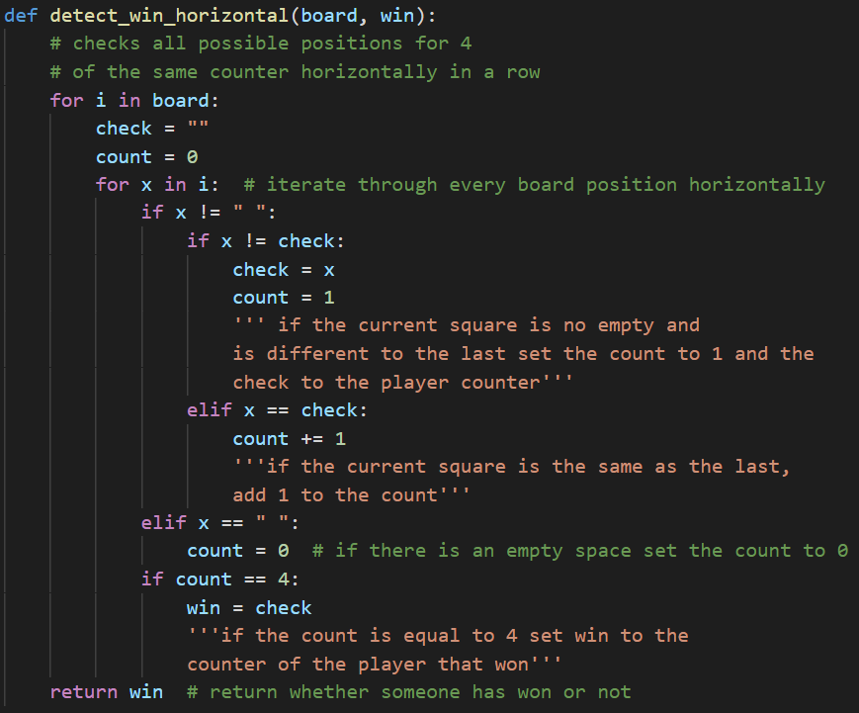
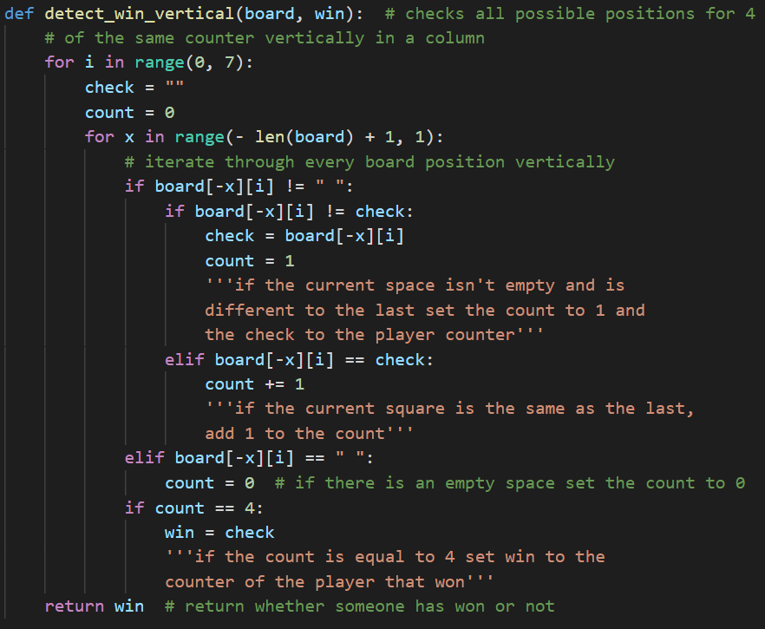
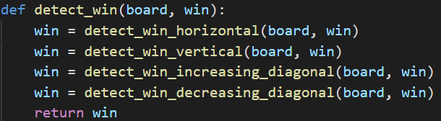
Decomposing outcome - Detect Win

Slide 12
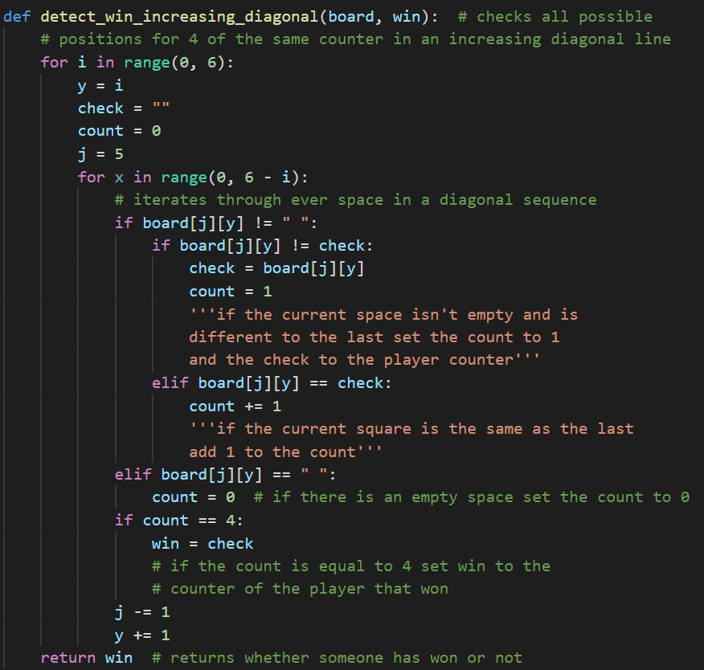
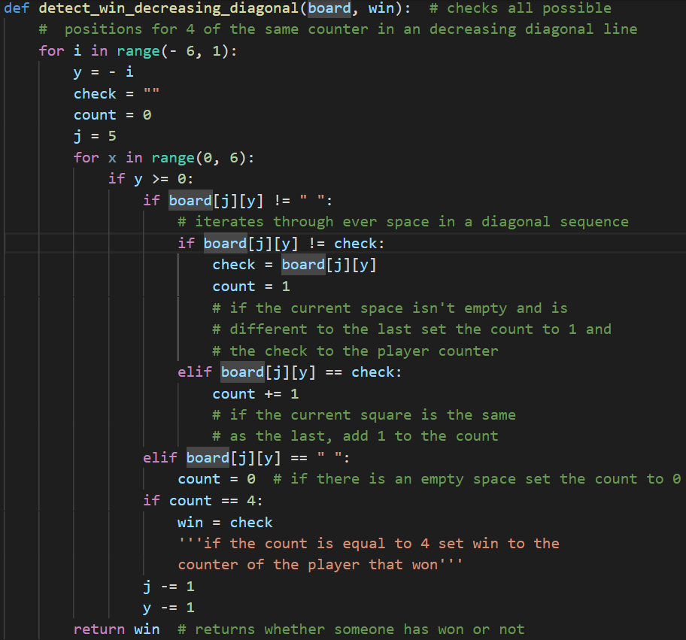
Decomposing outcome - Detect Win

Slide 13
Decomposing outcome - Detect Win
These functions check every possible position for a win condition until either it finds that a player has won or has checked ever space. This component will check for a win after every turn and return which player has won, if any. These functions use nested loops to check every horizontal, vertical and diagonal for 4 of the same counter in a row. I used this component because I want the users to be able to clearly see when a player has won without having to spend too much time looking every turn.

Slide 14
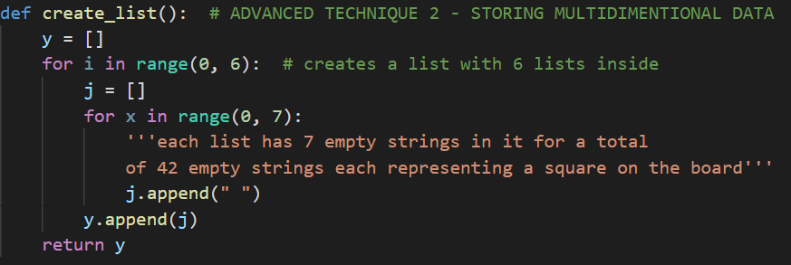
Decomposing outcome
This function creates a nested list which I use to store the data for every square on the board. I used a nested list because it allows me to easily access the data in a specific squared based on the coordinates of where it is in the board. I chose to use a function rather than just creating a list so that I could easily call it whenever I need to clear it at the start of each game.

Slide 15
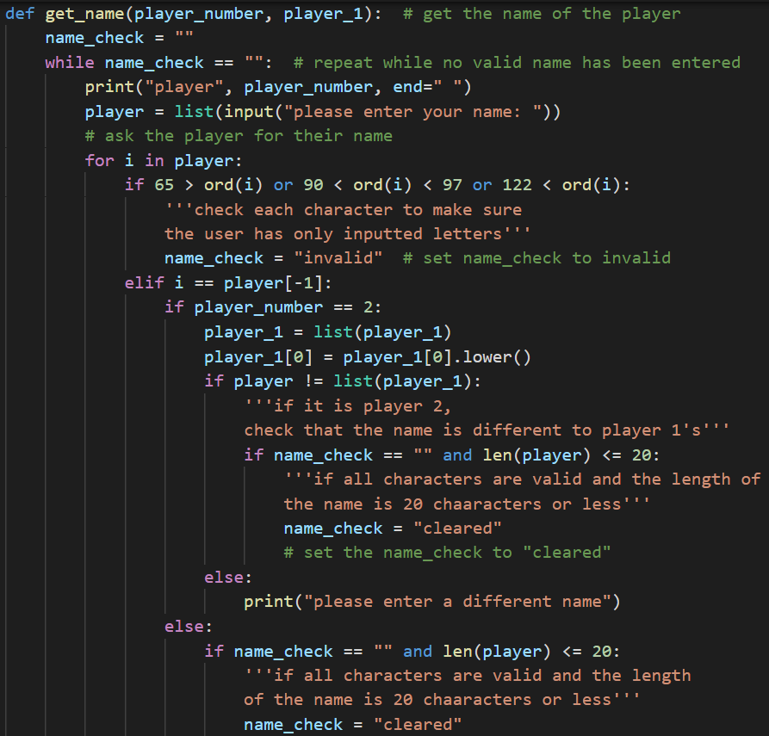
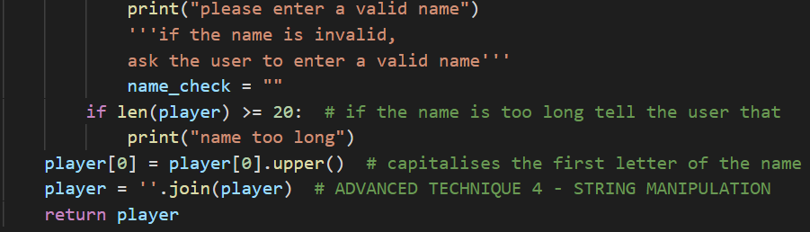
Decomposing outcome
This is the function that I use to get the players names. It checks each character to make sure the names consist of only letters and it checks whether the name is less than or equal to 20 characters or not. If the chosen name fails either of these checks, the player will be asked to enter a new name. If the second player’s name is the same as the first it will also ask the player to enter a new name. I included this to avoid confusion regarding which player won and which player’s turn it is. The function also capitalises the first letter of the name.

Slide 16
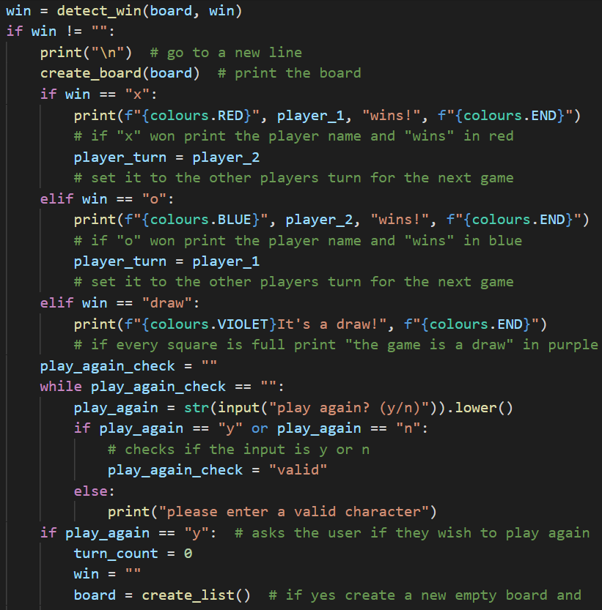
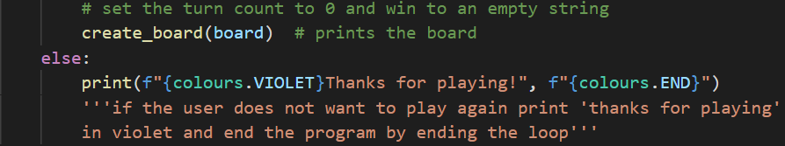
Decomposing outcome
This section of code prints out who won in that player’s colour and asks the players if they would like to play again. If they type ‘y’, the game will reset and if they don’t, the program will end. This component also has a turn timer to make sure that if the board is full and no one has won the game will be a draw.

Slide 17
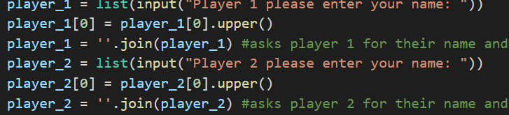
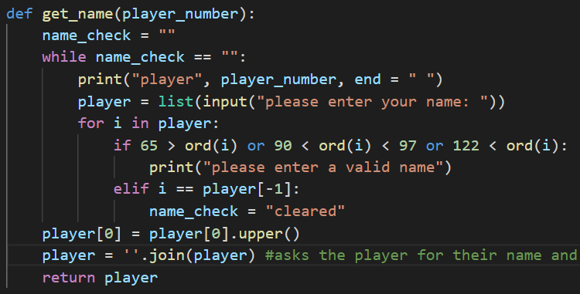
Trialling components - Comparing alternatives
Component 1
I wanted to have a component to ask both players for their names so i can use that to tell the players whose turn it is and to declare the winner. To do this I created 2 different components as shown of the left. The first gets the players input and capitalises the first letter and the second component does the same thing but it is a function and it also runs a check to make sure every character is a letter. I decided to use the second option because I want to make sure sure that the players are only using letters to avoid any confusion and I also think that it is better that it is a function because that allows me to use the same code for both players without having to copy the whole section.
Component 2

Slide 18
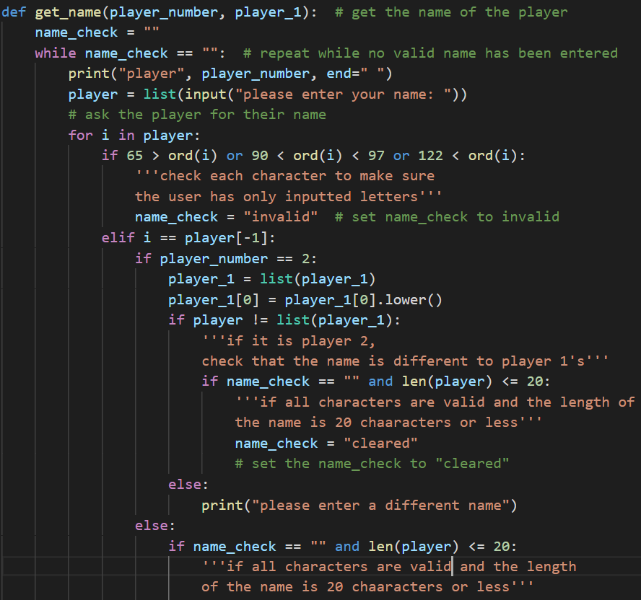
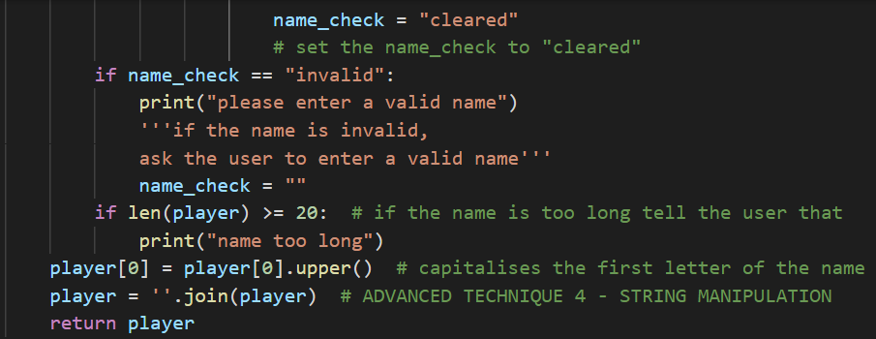
Trialling components - Comparing alternatives
Component 3
I later revised my previous iteration of this function by adding a few more checks. One check I added was a section to make sure that the players names were different, this was to fix a bug I was having where both players names would be the same colour if their names were the same and it also just helps to avoid any confusion. I also made this component check that the player’s names are 20 characters or less. I think that this is an improvement over my other two designs because it minimises any confusion that players could unintentionally create with their name choices.

Slide 19
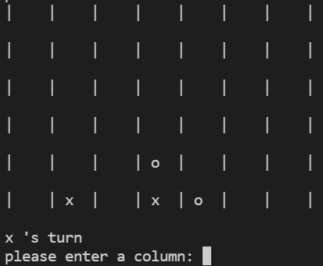
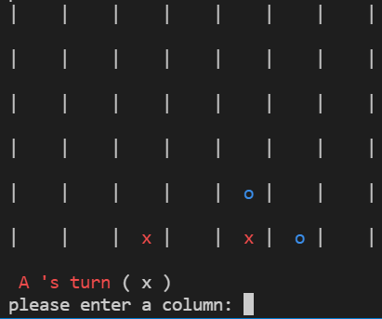
Trialling - Stakeholder feedback
My initial design had the board and all text in white which made it quite difficult to differentiate between the counters on the board. One of my stakeholders suggested that I add colours to make the counters as easy to see as possible.
Before
After

Slide 20
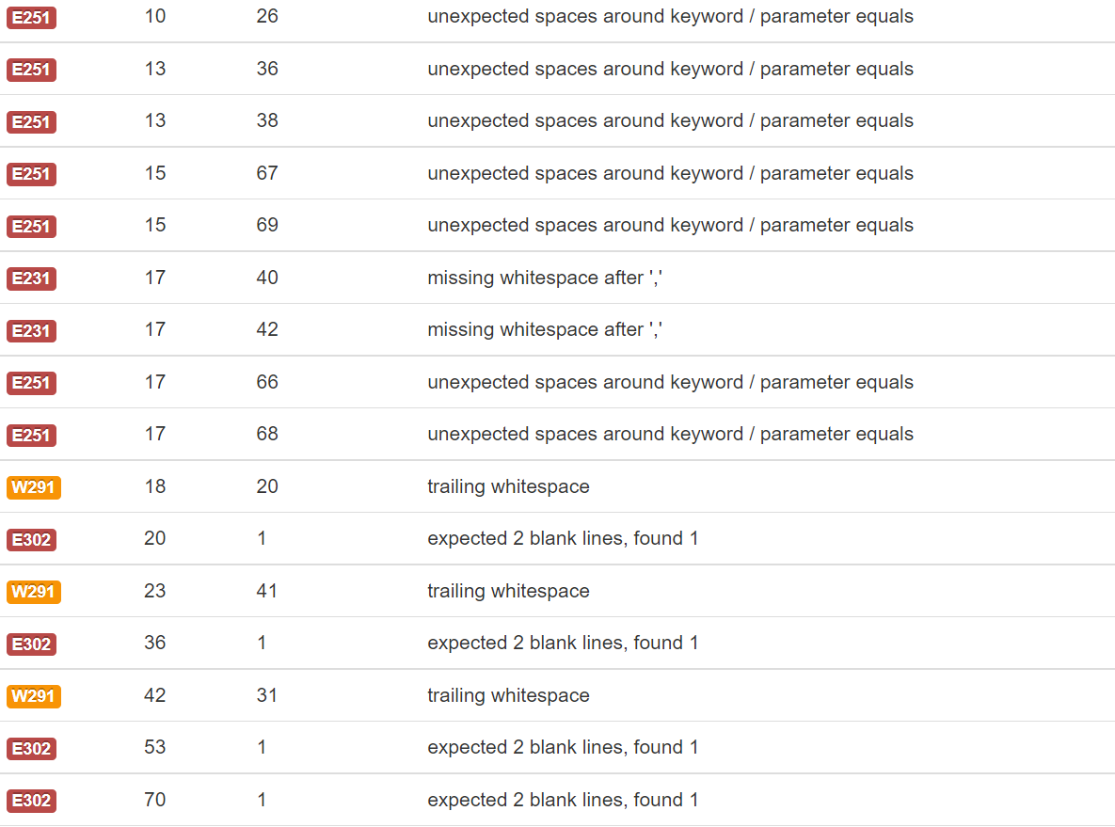
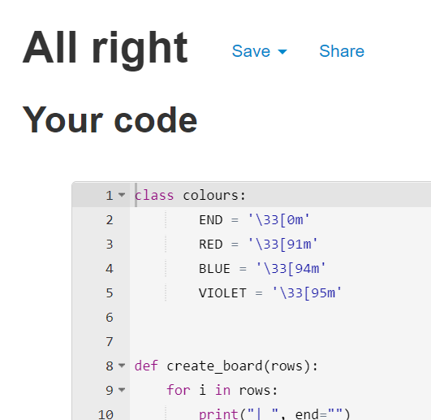
Testing outcome - Code validation
I used an online pep8 checker to make sure that my program met all the required python conventions. I had a lot of issues at first, such as extra whitespaces and having too many characters on a line, but I resolved all of these issues.

Slide 21
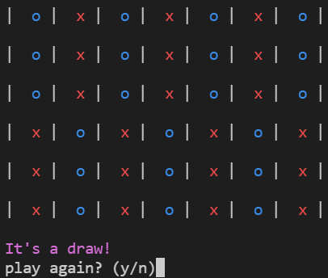
Trialling - Peer testing
When I got one of my peers to test my design he realised that there is a possibility that the game could end in a draw if the whole board is full and no one has won and the system is not set up to handle that. So I implemented a turn counter to track how full the board is and I made the game declare a draw if there is no more free spaces.

Slide 22
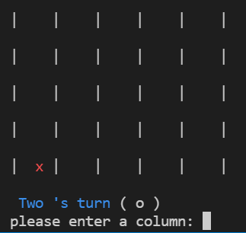
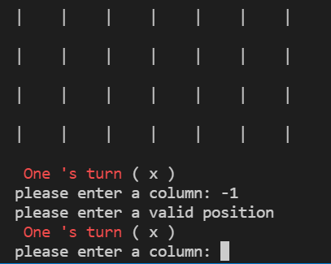
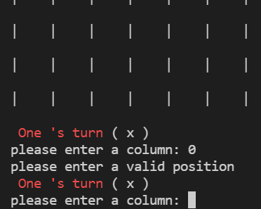
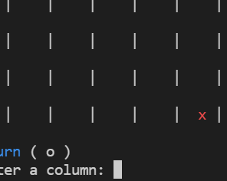
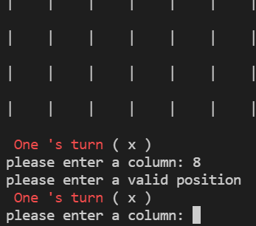
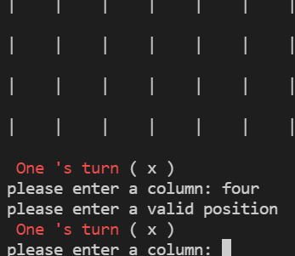
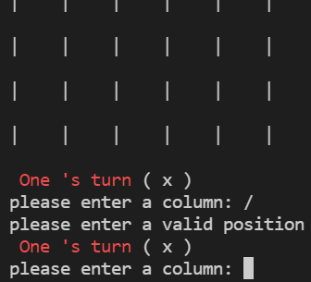
Testing outcome - Placing counters
I wanted to have a feature to allow the user to select a column to place their counter at the bottom of. The program should allow inputs from 1 and 7 and ask the user to enter a new input for anything else. I used this testing table to check a variety of possible inputs to make sure that the program would handle each of them correctly.
-1 | 0 | 1 | 7 | 8 | four | /

Slide 23
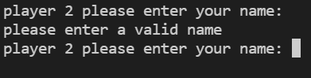

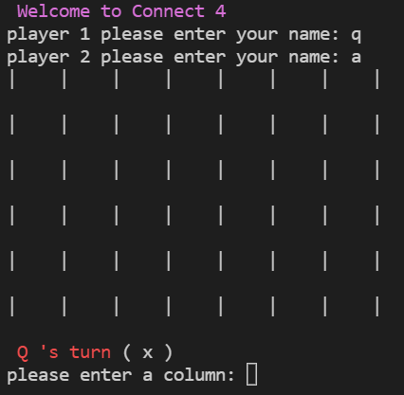



Testing outcome - Get Name
I wanted to add a component that asks for the players’ names and checks whether they meet certain requirements, such as only being letters, being 20 or less characters long and being different to the other player’s name. I used a testing table to check that the system handle all possible inputs correctly.
whitespace | 1 | a | / | 21 characters | Same as the other player’s name

Slide 24
Testing outcome - Recording
https://www.loom.com/share/3e7c95309d42438ea18fe5279d9f5d56

Slide 25
Social Implications
Social implications relate to how a digital outcome affect different social groups. It is important for an outcome to appeal to as many social groups as possible.
In this digital era it is rarer that people play games with each other in person. My connect 4 game aims to change that by forcing people to play together on the same computer, without any single player mode. My program also avoids offending anyone by avoiding the use of swearing and offensive language in all parts of my project. This game appeals to most social groups by not being exclusive in any way, other than the requirement of a device to play it on. However people with impared vision might struggle to play if they can’t see the screen.

Slide 26
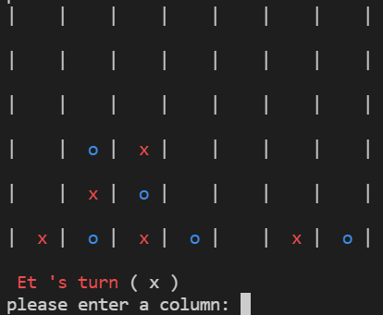
End User Implications
The end user is a very important part of any program as their needs are the most important needs to satisfy, since they will be using the program. End user implications relate to the specific needs of the user, such as how easy it is for a user to understand and use. End user considerations can also include things like, is the program in the right language for the target demographic and
My program is easy for the user to use because the game is very simple to understand and the level of english I have used is low enough that anyone that can read can understand it. I have used different colours and symbols for the player counters to make it as easy as possible for the user to see what player controls each square, even if the user is colour blind, or finds it difficult to to see the difference in shape between the small symbols.

Slide 27
Privacy Implications
Privacy implications relate to how users data is kept confidential in a digital outcome. Users often trust a lot of their personal information with developers so it is important that this information is kept private as is used with any malicious intent.
My program asks the players for their names. This is so to make each game feel personalised and unique. These names do not have to be the players real names and can instead be usernames, initials or whatever the users desire as they are just for fun. My program also doesn’t store any of the names in order to keep the user’s information as secure as possible. So none of the information can be sold or used for any other purpose.

Slide 28
Evaluate
I used trello to manage my project. This helped me to see my progress throughout my design process and to see what I had done and had left to do. This helped me to manage my time effectively and get my project done on time and have a successful outcome.
I trialled my design with multiple people from different social groups. This helped me to know what I needed to change to create a better outcome and it also helped me to see what aspects of my design were good. This made me realise that I needed to add colour and a way to have the game end in a draw. This helped me to create an outcome that appeals to my audience.
I tested my design a lot, specifically the function for getting the players’ names. I realised that if both players had the same name they would appear in the same colour so I had to make it so that the second player must choose a different name. I also had an issue where if the column that the user wants to put the counter in is full the game would just end, so I had to implement a check to make sure that there was a space in the column and otherwise ask the user to choose a different column.
Overall I am satisfied with my outcome and I think that the processes that I used helped me to create a good digital outcome that meets my requirements. However if I had more time I would’ve liked to add an ai so that the user can play alone and I would’ve also liked to let the players select their colour instead of limiting it to only red and blue in order to give the players more personalisation options.

